Slide 1

CSC 533: Privacy in the Digital Age (Fall 2020) Lecture 13: Social networks and privacy
Anupam Das
Sept. 24, 2020

Slide 2
Goals for today
Different types of social networks
Common privacy issues with social networks
Privacy interventions for social networks
Some slide content taken from Abby Marsh, Manya Sleeper, Adam C. Champion and Dong Xuan

Slide 3
Online Social Networking (OSN)
Online web services enable people to connect with each other, share information
Common friends, interests, personal info, …
Post photos, videos, etc. for others to see
Communicate via email, instant message, etc.
Major OSN services: Facebook, Twitter, MySpace, LinkedIn, etc.

Slide 4
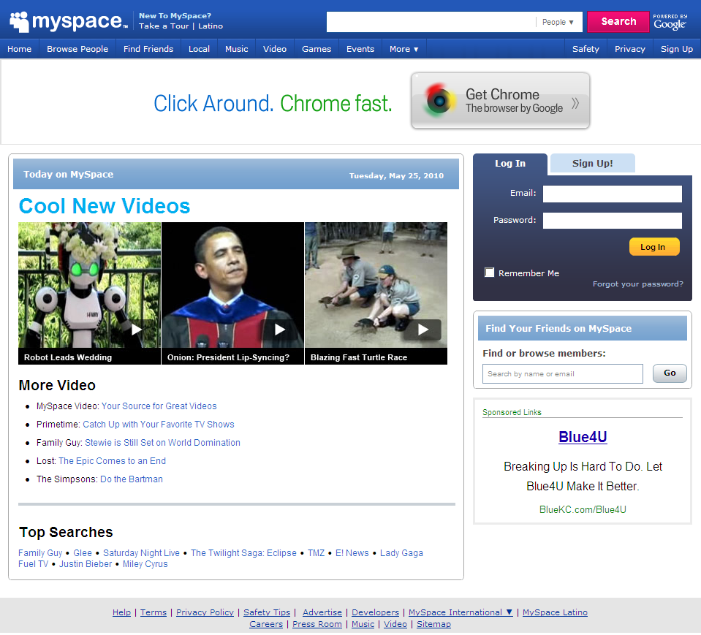
“MySpace is a place for friends.”
“MySpace is Your Space.”
“MySpace keeps you connected.”
Notes:
Grandaddy of social networking sites (meaning it was one of the first)
Started in 2003, official launch in 2004
Claims “113 million monthly active users around the globe” - http://www.myspace.com/pressroom?url=/fact+sheet/
But others dispute that and claim the real numbers are much less:
http://www.dailyfinance.com/story/company-news/myspaces-dwindling-traffic-looks-even-worse-from-the-inside/19380431/

Slide 5
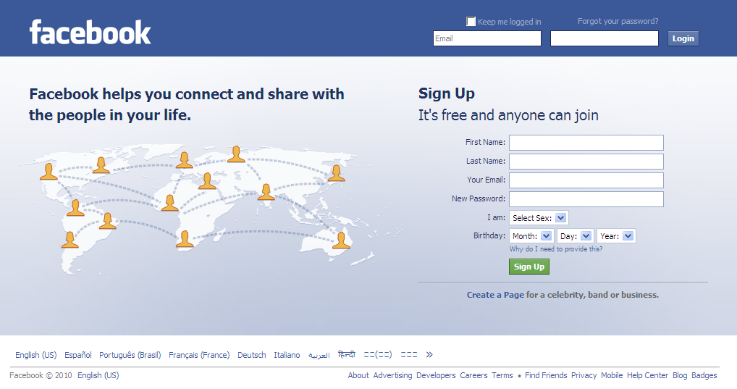
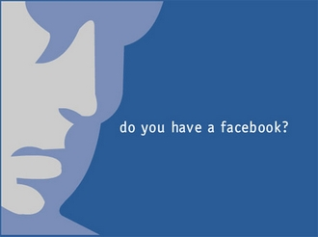
“Giving people the power to share and make the world more open and connected.”
Notes:
Overtook MySpace as most popular social networking site in 2008
Wildly popular now with over 400 million users
“Facebook is an online directory that connects people through social networks at schools” (Facebook.com)
Launched to the public Wednesday Feb 4, 2004
Harvard students created the site as a tool to connect with other students in their community
It announces birthdays, events and invitations
Start-up based in Palo Alto, California
Begin small and is now one of the top ten most visited sites on the web and is profitable

Slide 6
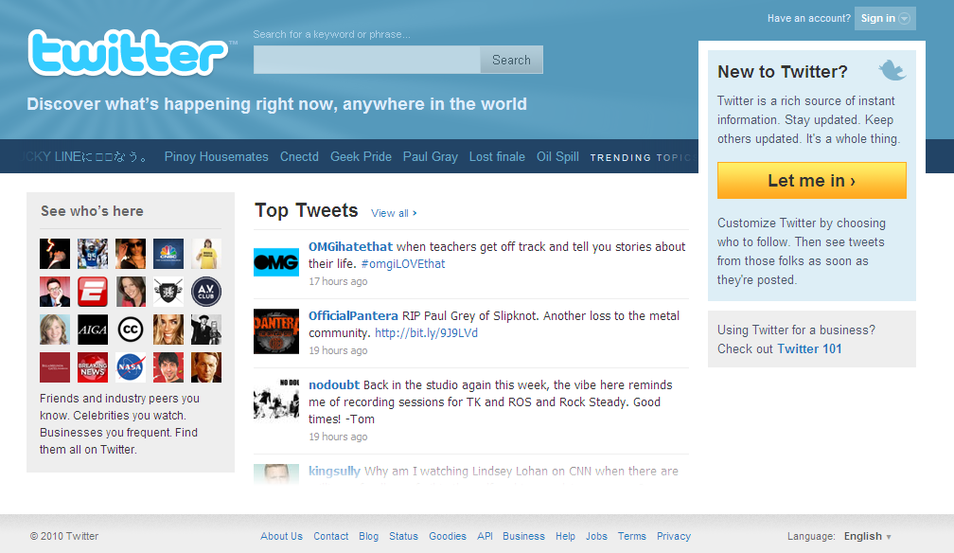

“Twitter is a service for friends, family, and co-workers to communicate and stay connected through the exchange of quick frequent answers to one simple question:
What are you doing?”
Notes:
Attractive to our “sound bite” culture since communication limited to 140 character “tweets”
Gave a boost to URL shortening services like tinyURL and bit.ly
Library of Congress plans to archive ENTIRE archive of tweets!
From http://blogs.loc.gov/loc/2010/04/how-tweet-it-is-library-acquires-entire-twitter-archive/ :
“Every public tweet, ever, since Twitter’s inception in March 2006, will be archived digitally at the Library of Congress. That’s a LOT of tweets, by the way: Twitter processes more than 50 million tweets every day, with the total numbering in the billions.”

Slide 7
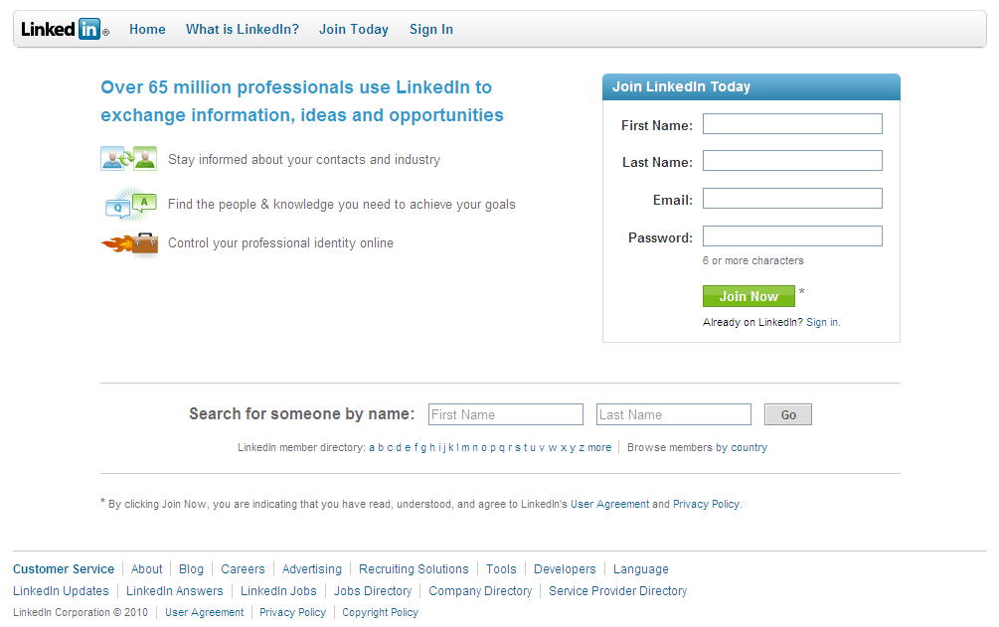

“Your professional network of trusted contacts gives you an advantage in your career, and is one of your most valuable assets. LinkedIn exists to help you make better use of your professional network and help the people you trust in return.”

Slide 8
Many social networks out there
Country specific, interest specific
Varied functionalities, focuses, norms, etc.
Notes:
Are literally hundreds of social networking services, growing daily, but much volatility. Which will be the next Facebook?

Slide 9
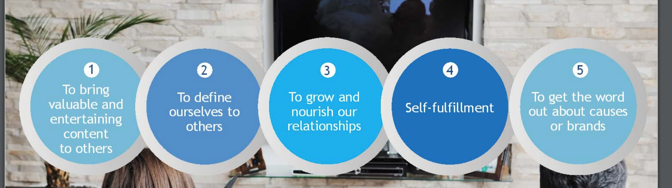
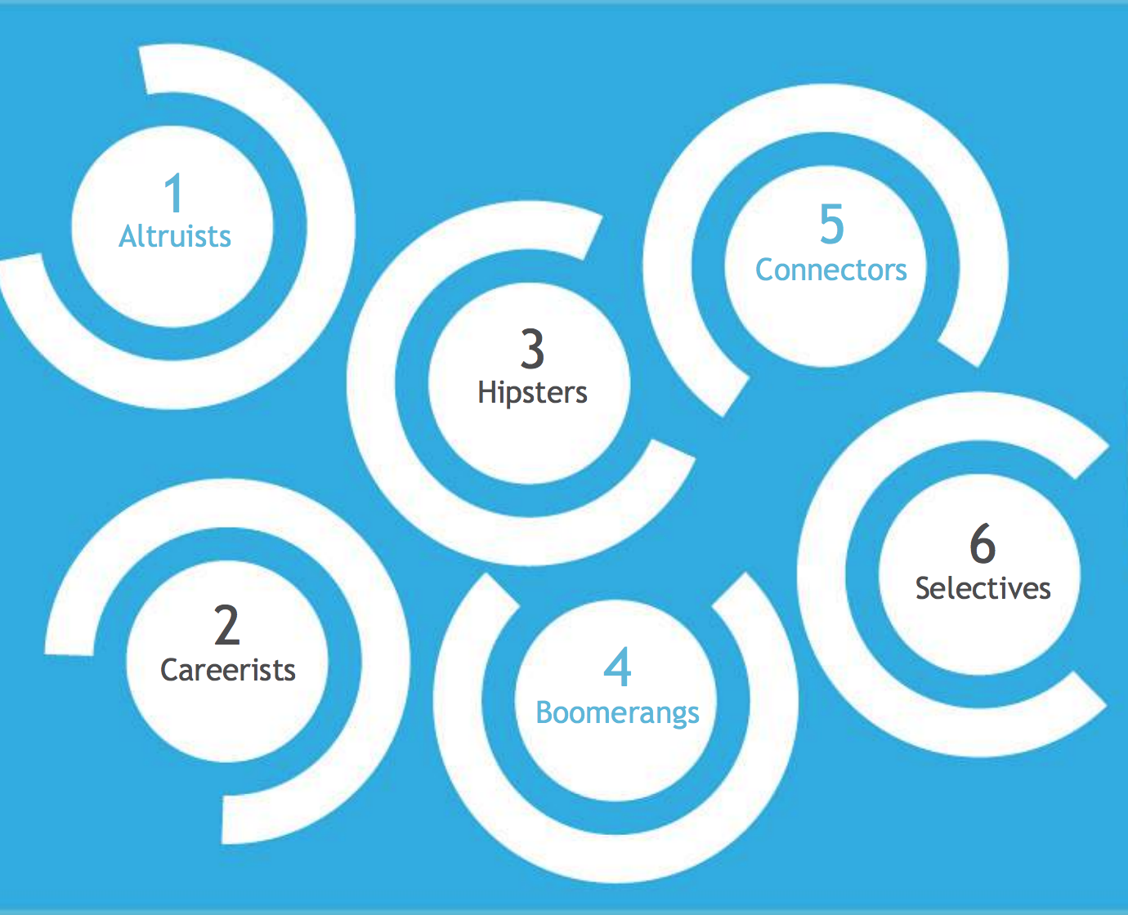
The psychology of social sharing
Why we share?
Six personas of online sharers
New York times: http://templatelab.com/the-psychology-of-sharing/

Slide 10
OSN popularity
Over 2.4 billion Facebook users worldwide
Over 190 million in U.S.
Over 2.2 billion access via mobile
Over 330 million Twitter users; over 500 million Tweets sent daily
Over 630 million LinkedIn members
Which country has more FB users?
https://www.omnicoreagency.com/facebook-statistics/
https://www.omnicoreagency.com/twitter-statistics/
https://www.omnicoreagency.com/linkedin-statistics/

Slide 11
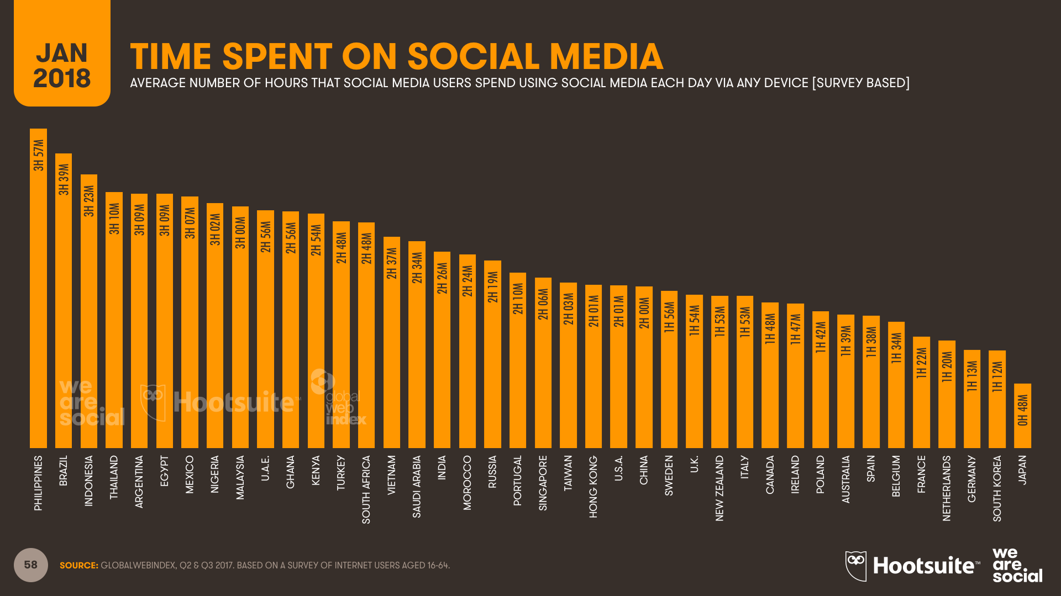
How long do users spend on OSNs?
In US daily on average people spend 2hr on social media

Slide 12
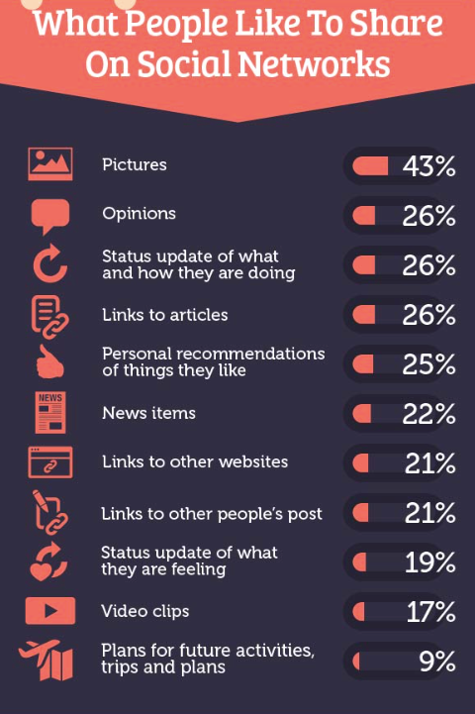
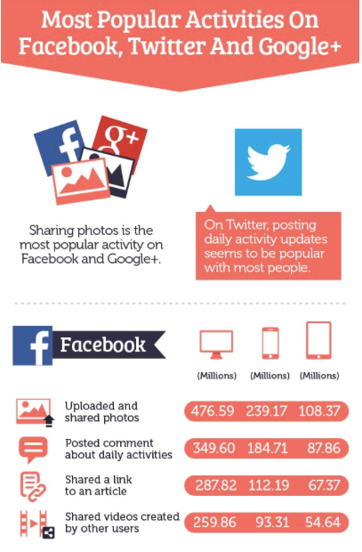
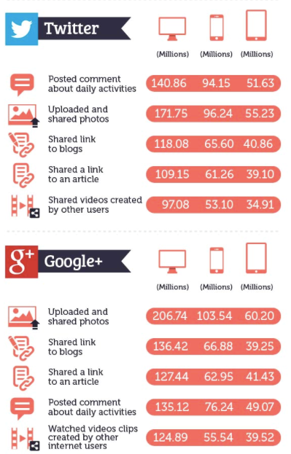
What content people share in ONSs?
https://kimgarst.com/what-do-people-love-to-share-on-social-media/

Slide 13
ONSs have different properties
Many different sites: Facebook, Twitter, Reddit, Snapchat, Instagram, Linkedin, etc.
Varied functionalities, focuses, norms, etc.
Different types of users
Enable communication between people
Two-way? Multi-user threads? Group messaging?
Broadcast or private?
Anonymous, pseudonymous, or named?

Slide 14
Benefits of OSN communication
Vast majority of college students use OSNs
Organizations want to market products, services, etc. to this demographic
OSNs can help them reach these potential buyers
OSNs provide communal forum for expression (self, group, mass), collaboration, etc.
Connect with old friends, find new friends and connect
Play games with friends, e.g., Mafia Wars, Scrabulous
Commerce in “virtual items”
But using OSNs poses security and privacy issues for organizations as well as individuals

Slide 15
Common Privacy Issues with OSNs

Slide 16
OSN Privacy Risks
Phishing attacks
Cyber harassment, stalking, etc.
Information “shelf life” in cyberspace
Privacy issues:
Information about person posted by him/herself, others
Information about people collected by OSNs
Information posted on OSNs impacts unemployment, insurance, etc.
Organizations’ concerns: brand name, laws, regulations

Slide 17
OSN phishing attacks
How many suspicious accounts in Facebook and Twitter?
Directs users to a legitimate looking website where instead of claiming the new shoes, inputting their credit card information signs them up for a $49.99 monthly subscription service.
In 2017
Facebook 270 million accounts were illegitimate
Twitter identified over 70 million suspicious accounts
https://corrata.com/the-rising-threat-of-social-media-phishing-attacks/

Slide 18
URL shorteners
bit.ly, TinyUrl, ReadThisURL, NotLong became popular because of OSNs
Hides the true destination URL – hard to tell where you’re going until you click!
http://www.evil.com/badsite?%20infect-your-pc.html
is now
http://bit.ly/aaI9KV

Slide 19
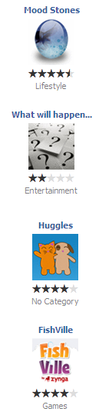
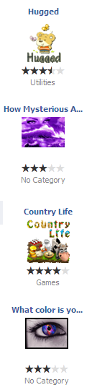
OSN 3rd party applications
Games, quizzes, “cute” stuff
Untested by Facebook – anyone can write one…
No Terms and Conditions – either allow or deny
Installation gives developers rights to look at your profile and overrides your privacy settings!
There’s a sucker born every minute.
–P.T. Barnum

Slide 20
OSN stalking, harassment, etc.
Bullies, stalkers, etc. harass people via OSNs
High-profile example: Megan Meier’s suicide
13-year old Meier killed herself after chatting on MySpace with a 16-year-old boy who made degrading remarks
The “boy” was a fake account set up by Lori Drew, mother of Meier’s ex-friend
Drew found guilty of violating Computer Fraud and Abuse Act in 2008; acquitted in 2009
Most U.S. states have since criminalized cyber harassment, stalking, etc.
OSNs (and their members) have played similar roles in mistreating people
Wikipedia, https://en.wikipedia.org/wiki/Suicide_of_Megan_Meier

Slide 21
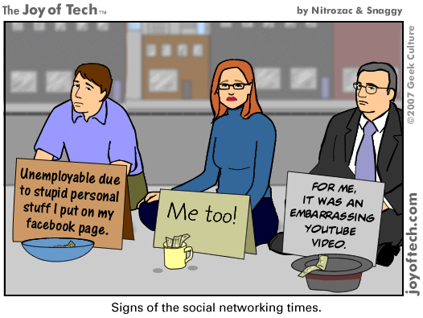
OSN information “Shelf Life”
Common sense: it’s very difficult to delete information after it’s been posted online
Indiscreet information can adversely affect college admissions, employment, insurance, etc.
Twitter gave its entire archive to Library of Congress in 2010

Slide 22
OSN information privacy (1)
Employers, insurers, college admissions officers, et al. already screen applicants using OSNs
Recent report from Novarica, research consultancy for finance and insurance industries:
“We can now collect information on buying behaviors, geospatial and location information, social media and Internet usage, and more…Our electronic trails have been digitized, formatted, standardized, analyzed and modeled, and are up for sale. As intimidating as this may sound to the individual, it is a great opportunity for businesses to use this data.” (quoted in [1])
Consumer Reports, Jun. 2012, http://www.consumerreports.org/cro/magazine/2012/06/ facebook-your-privacy/index.htm

Slide 23
OSN information privacy (2)
Posts that got people fired:
Connor Riley: “Cisco just offered me a job! Now I have to weigh the utility of a [big] paycheck against the daily commute to San Jose and hating the work.”
Tania Dickinson: compared her job at New Zealand development agency to “expensive paperweight”
Virgin Atlantic flight attendants who mentioned engines replaced 4 times/year, cabins with cockroaches
D. Love, “13 People Who Got Fired for Tweeting,” 16 May 2011, http://www.businessinsider.com/twitter-fired-2011-5?op=1
C. Smith and C. Kanalley, “Fired Over Facebook: 13 Posts That Got People Canned,” http://www.huffingtonpost.com/2010/07/26/fired-over-facebook-posts_n_659170.html

Slide 24
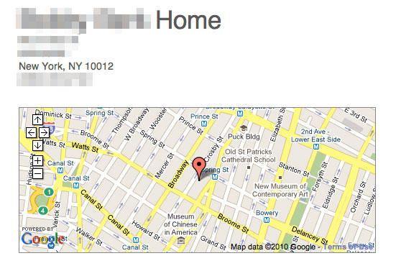



OSN information privacy (3)
Information posted on OSNs is generally public
Unless you set privacy settings appropriately
“I’ll be on vacation” post plus geolocation invites burglars, i.e., “Please Rob Me”
Indiscreet posts can lead to nasty consequences
http://pleaserobme.com/

Slide 25
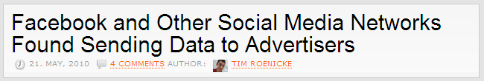
OSN information privacy (4)
OSNs don’t exactly safeguard posted info…
Facebook
“You hereby grant Facebook an irrevocable, perpetual, non-exclusive, transferable, fully paid, worldwide license (with the right to sublicense) to (a) use, copy, publish, stream, store, retain, publicly perform or display, transmit, scan, reformat, modify, edit, frame, translate, excerpt, adapt, create derivative works and distribute (through multiple tiers), any User Content you (i) Post on or in connection with the Facebook Service or the promotion thereof subject only to your privacy settings or (ii) enable a user to Post, including by offering a Share Link on your website and (b) to use your name, likeness and image for any purpose, including commercial or advertising, each of (a) and (b) on or in connection with the Facebook Service or the promotion thereof. You may remove your User Content from the Site at any time. If you choose to remove your User Content, the license granted above will automatically expire, however you acknowledge that the Company may retain archived copies of your User Content.”
LinkedIn
Additionally, you grant LinkedIn a nonexclusive, irrevocable, worldwide, perpetual, unlimited, assignable, sublicenseable, fully paid up and royalty-free right to us to copy, prepare derivative works of, improve, distribute, publish, remove, retain, add, process, analyze, use and commercialize, in any way now known or in the future discovered, any information you provide, directly or indirectly to LinkedIn, including but not limited to any user generated content, ideas, concepts, techniques or data to the services, you submit to LinkedIn, without any further consent, notice and/or compensation to you or to any third parties. Any information you submit to us is at your own risk of loss.

Slide 26
Organizations and OSNs (1)
Organizations subject to attacks via OSNs
Defamation, damage to org. brand, ™
Unauthorized people posting on behalf of org.
Negative media coverage, reputation damage
Case study: BP oil spill fallout
Summer 2010: Deepwater Horizon spill (87 days)
BP’s public relations didn’t cover OSNs well
Angry citizens post on OSNs (@BPglobalPR had 179,000 followers)
BP logo “remixed” as oil spill; negative press coverage

Slide 27
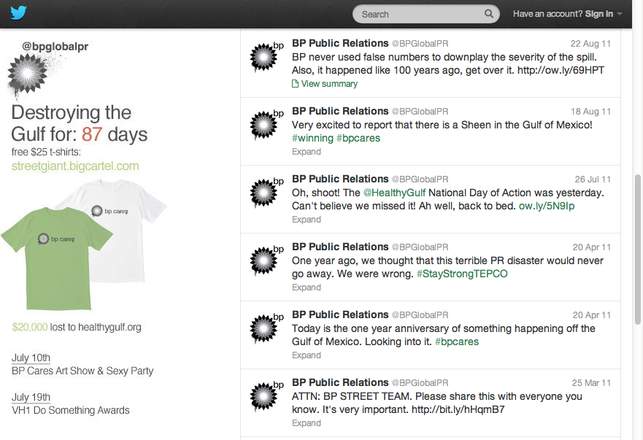
Organizations and OSNs (2)

Slide 28
Change in Terms of Service
What happens to your data when an ONS changes its privacy policy?
What recourse does a user have?
Stutzman et al. (2012):
FB’s privacy settings wizard changes and additional updates made many users’ private information public
These changes were a major part of 2011 FTC action against Facebook [1]
[1] https://www.ftc.gov/news-events/press-releases/2011/11/facebook-settles-ftc-charges-it-deceived-consumers-failing-keep

Slide 29
FTC charges against Facebook
In December 2009, Facebook changed its website so certain information that users may have designated as private – such as their Friends List – was made public.
Facebook represented that third-party apps that users' installed would have access only to user information that they needed to operate. In fact, the apps could access nearly all of users' personal data – data the apps didn't need.
Facebook told users they could restrict sharing of data to limited audiences – for example with "Friends Only." In fact, selecting "Friends Only" did not prevent their information from being shared with third-party applications their friends used.
Facebook had a "Verified Apps" program & claimed it certified the security of participating apps. It didn't.
Facebook promised users that it would not share their personal information with advertisers. It did.
Facebook claimed that when users deactivated or deleted their accounts, their photos and videos would be inaccessible. But Facebook allowed access to the content, even after users had deactivated or deleted their accounts.
Facebook claimed that it complied with the U.S.- EU Safe Harbor Framework that governs data transfer between the U.S. and the European Union. It didn't.

Slide 30
Forgetting my audience
Who can see what you share online?
Bernstein et al. (2013):
Users estimate their audience is 27% of its actual size
Likes, comments, and friend count are bad indicators of audience size for a post
How much audience do you have across different networks?
Bernstein et al. (2013): Quantifying the invisible audience in social networks

Slide 31
Audience changes over time
What are the privacy implications of using an ONS for multiple years?
Bauer et al. (2013):
People want same audience to have access to a post over time
People were bad at predicting how their privacy preferences for a post would change
Bauer et al. (2013): The Post Anachronism: The Temporal Dimension of Facebook Privacy

Slide 32
Audience: Context collapse
Context collapse is the flattening of a person’s multiple audiences into one large audience, caused by ONSs
combines separate offline groups (e.g., friends, family, coworkers)
Marwick and Boyd (2011):
Twitter users cannot vary their self-presentation by audience, so they must self-censor or balance their content
Users create an imagined audience for whom they construct their identity
Marwick, Alice E and Danah Boyd. I tweet honestly, I tweet passionately: Twitter users, context collapse, and the imagined audience. New Media & Society. 2011.

Slide 33
Regret about over-sharing
What are you likely to regret posting?
Sleeper et al. (2013):
Twitter users tended to regret tweets where they had criticized something, made an error, or shared a lot
Users would realize regret hours or days later, and delete or apologize for tweet
Manya Sleeper, Justin Cranshaw, Patrick Gage Kelley, Blase Ur, Alessandro Acquisti, Lorrie Faith Cranor, and Norman Sadeh. "I read my Twitter the next morning and was astonished": A Conversational Perspective on Twitter Regrets. In Proceedings of the SIGCHI Conference on Human Factors in Computing Systems, 2013. (CHI '13)

Slide 34
What leads to a regret?
57% of Americans who use social media have posted or texted something that they regret afterwards [YouGov Omnibus survey]
What actions lead to a regret?
Why might cause those actions to take place?

Slide 35
Exercise: Regrettable Actions
I shared pictures or messages that may affect my relationship with my family or partner
I shared pictures or messages that may affect my reputation at work
I made a comment in the heat of the moment and I may have offended many people
I sent “sexting” messages and am fearful that they may be shared
I made a comment in the heat of the moment and offended a friend
I didn’t properly consider a response and I sounded foolish
?

Slide 36
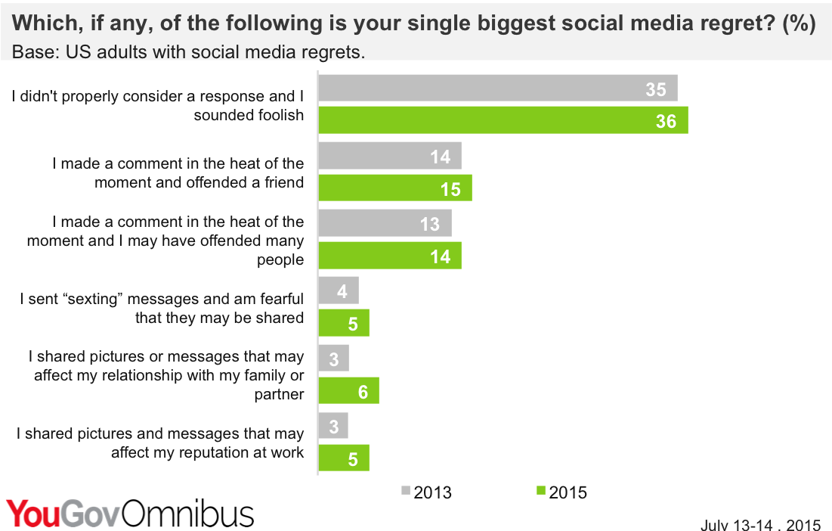
Regrettable Actions
https://www.huffingtonpost.com/entry/more-than-half-of-america_b_7872514

Slide 37
Exercise: Reasons for Regret
When I am with friends
On a laptop/computer
On my smartphone
When I have drunk some alcohol
At home
Late night when I am tired
When I am on my own
When I am busy and respond too quickly
In the office
?

Slide 38
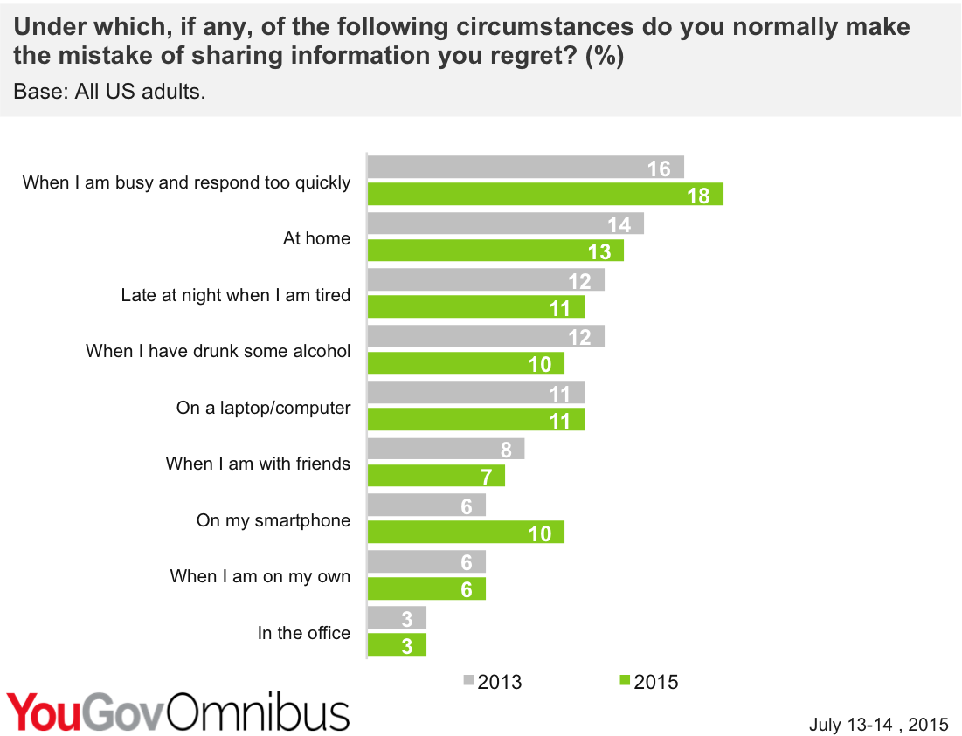
Reasons for regret
https://www.huffingtonpost.com/entry/more-than-half-of-america_b_7872514

Slide 39
Privacy interventions on SNSs

Slide 40
Privacy interventions
What are some privacy strategies used by SNSs?
Consider some scenarios: making a new post, managing friends lists, changing settings on old content
What do you think they’re doing well?
What do you think needs improvement?

Slide 41
Scenario: posting to Facebook
I want to share something with my female friends. How do I do it?
I could create a group… but I have to sort all my friends individually
Facebook could infer gender—what privacy risks exist there?
How could a user abuse a feature like this?
Attack certain vulnerable populations

Slide 42
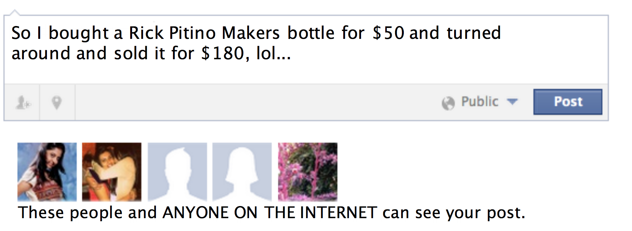
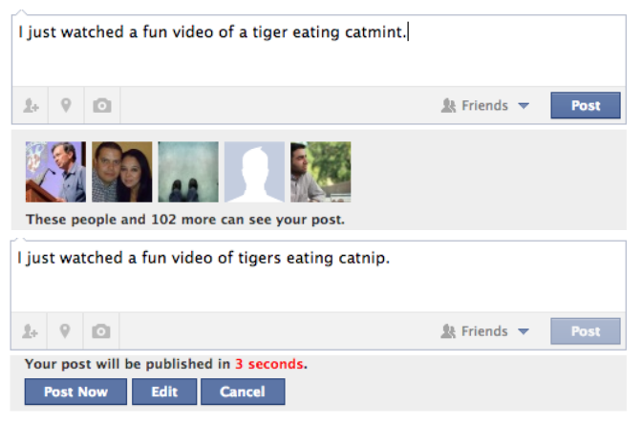
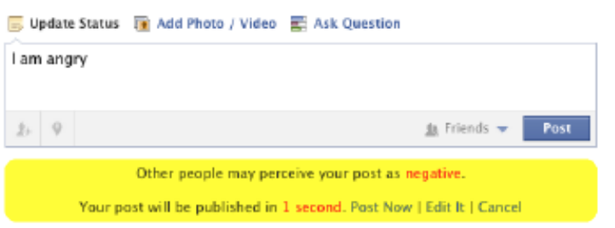
Samples of nudges
Yang Wang, Pedro Giovanni Leon, Alessandro Acquisti, Lorrie Faith Cranor, Alain Forget, and Norman Sadeh. A Field Trial of Privacy Nudges for Facebook. In Proceedings of the SIGCHI Conference on Human Factors in Computing Systems, 2014.

Slide 43
Intervention: Privacy nudges
What if we prompt (“nudge”) people to reconsider their posts to social media while they are making the post?
Wang et al. (2014):
Varied responses—some liked the nudges, others found them intrusive/ annoying

Slide 44
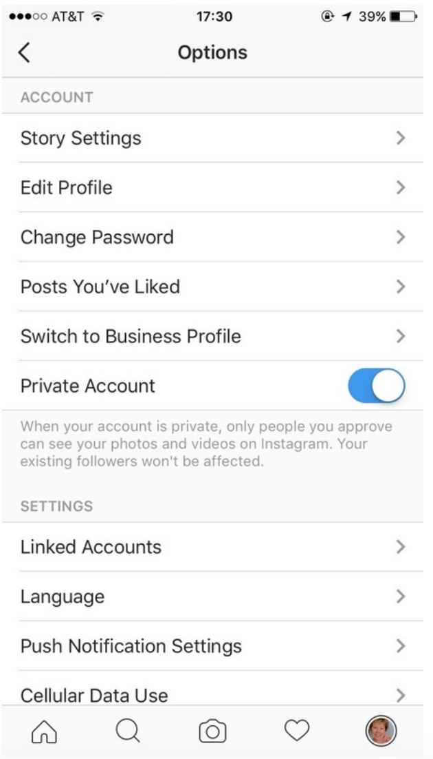
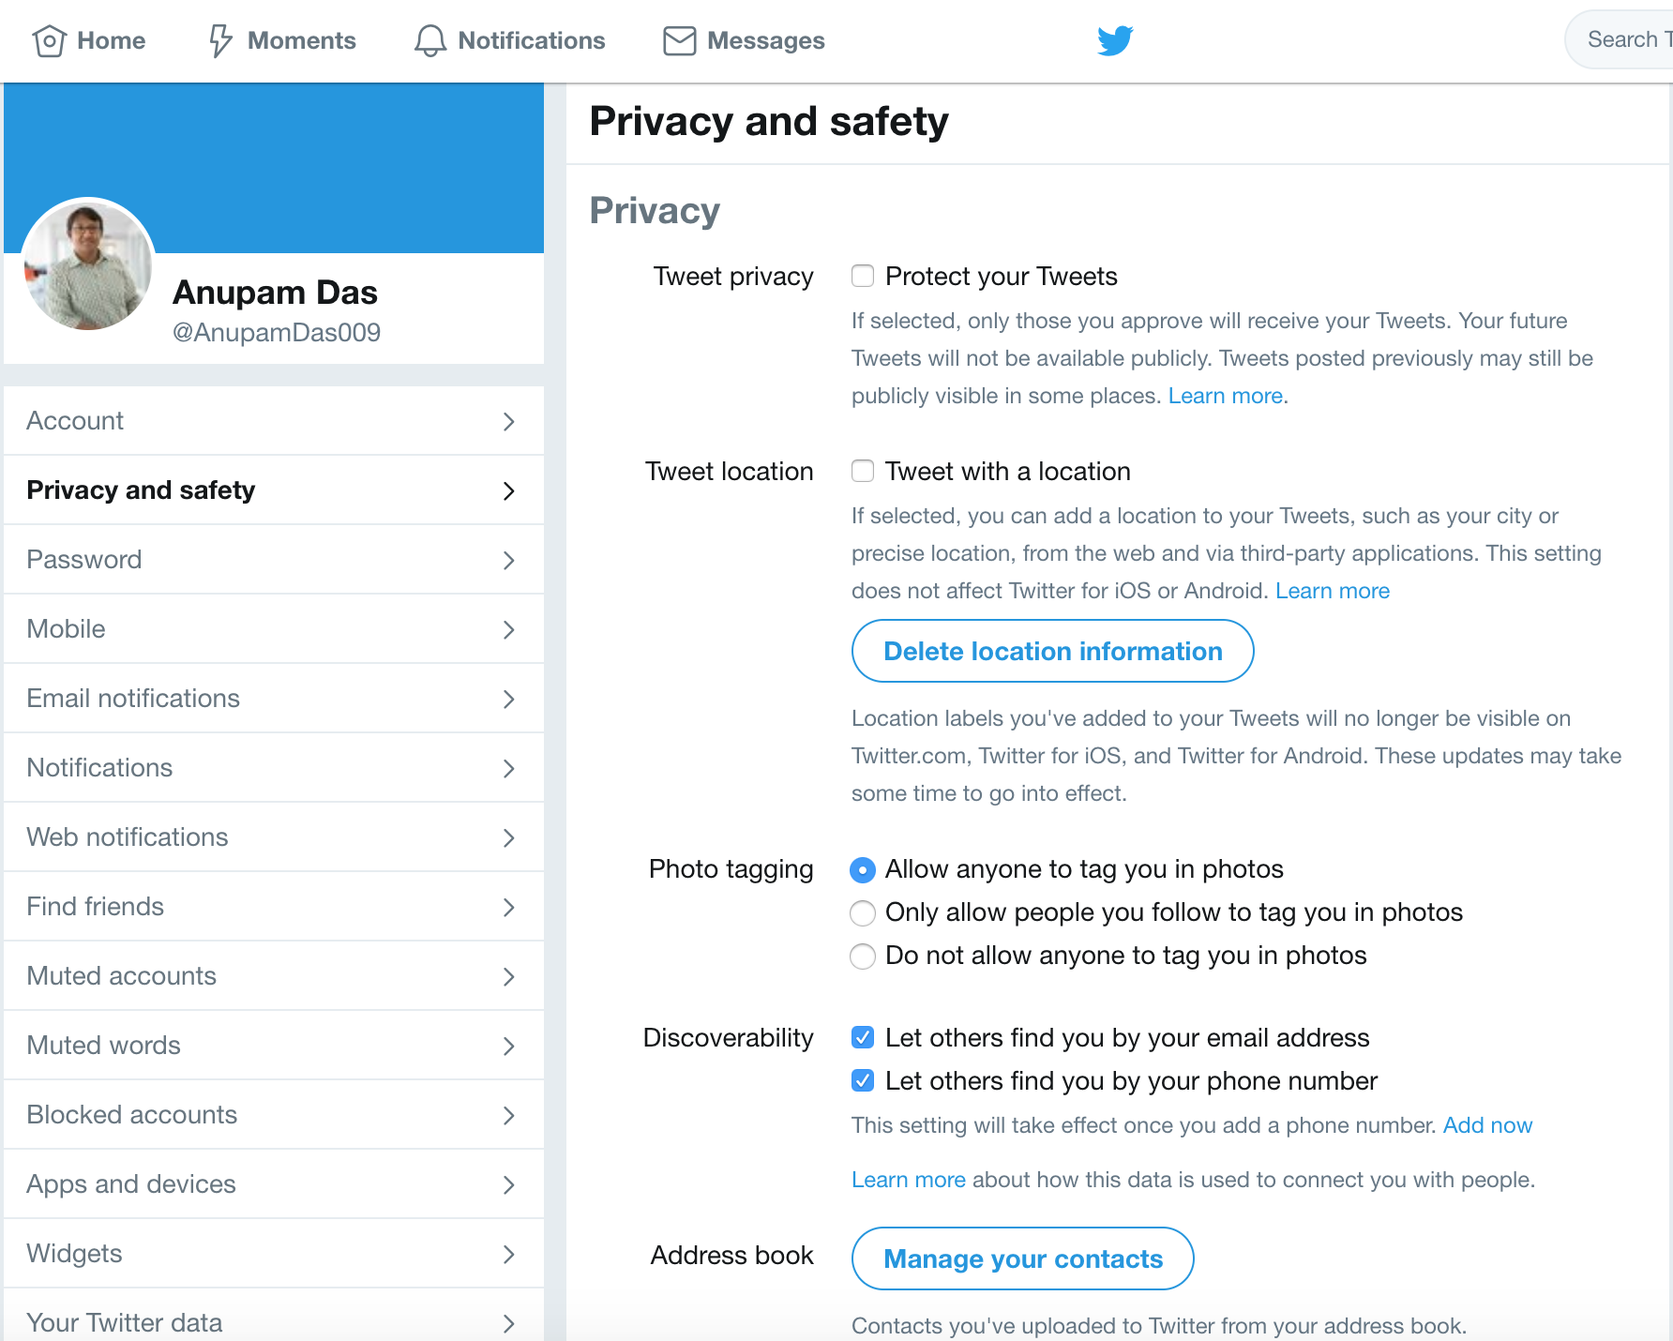
Intervention: Audience control
Instagram, Twitter, Tumblr, others use simple toggles for privacy
private mode
What works about this?
simple
What could be improved?
More options

Slide 45
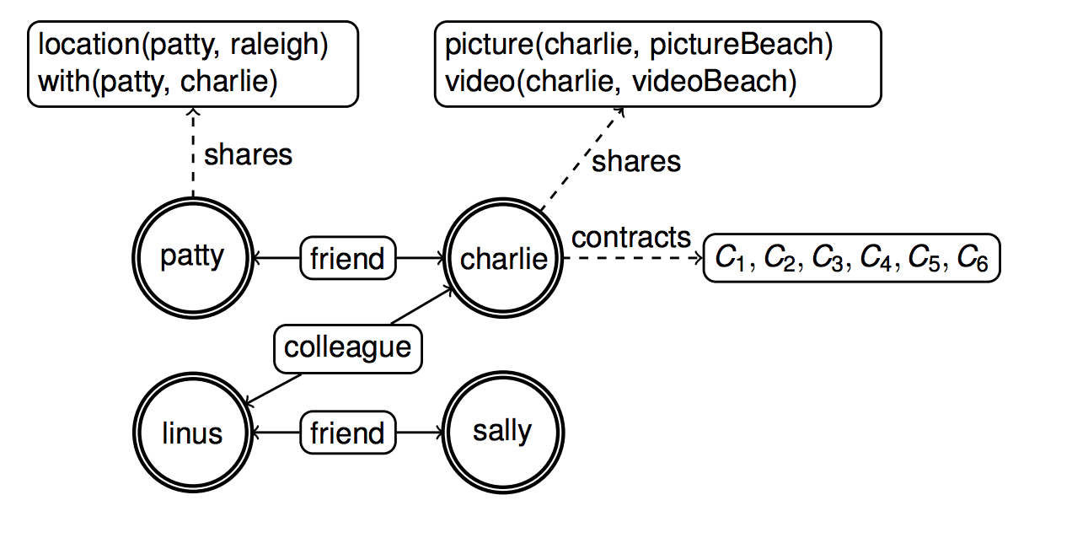
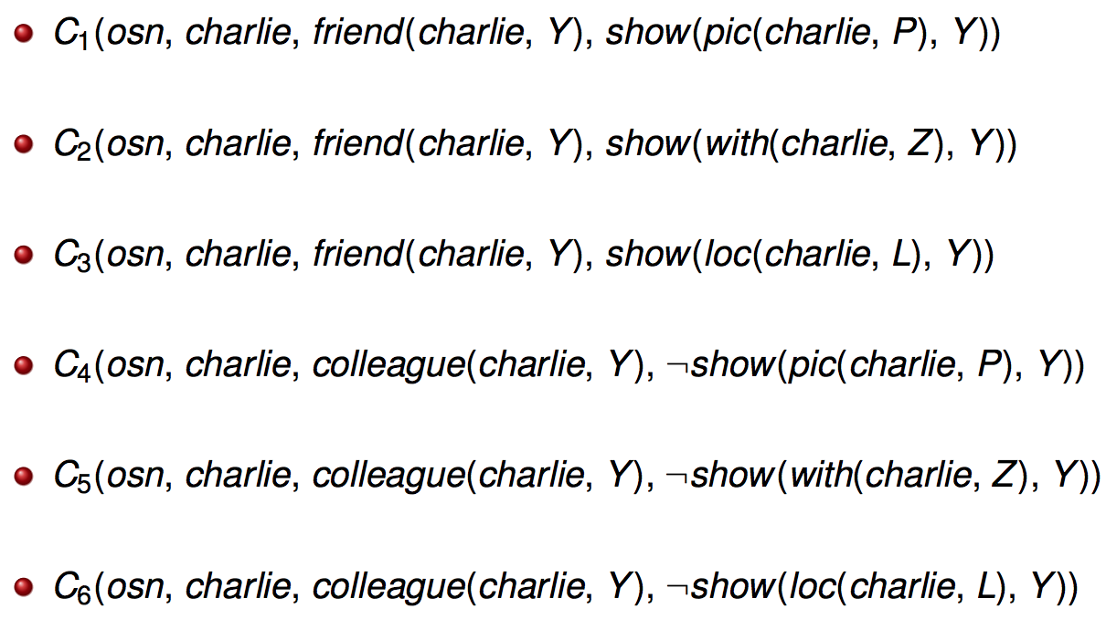
Intervention: Model/graph checking
Can we predict information leak before it happens?
Is it practical?
Charlie doesn’t want to share anything with colleagues
Özgür Kafalı, Akın Günay, and Pınar Yolum. Detecting and Predicting Privacy Violations in Online Social Networks. Distributed and Parallel Databases, 32(1):161-190, 2014

Slide 46
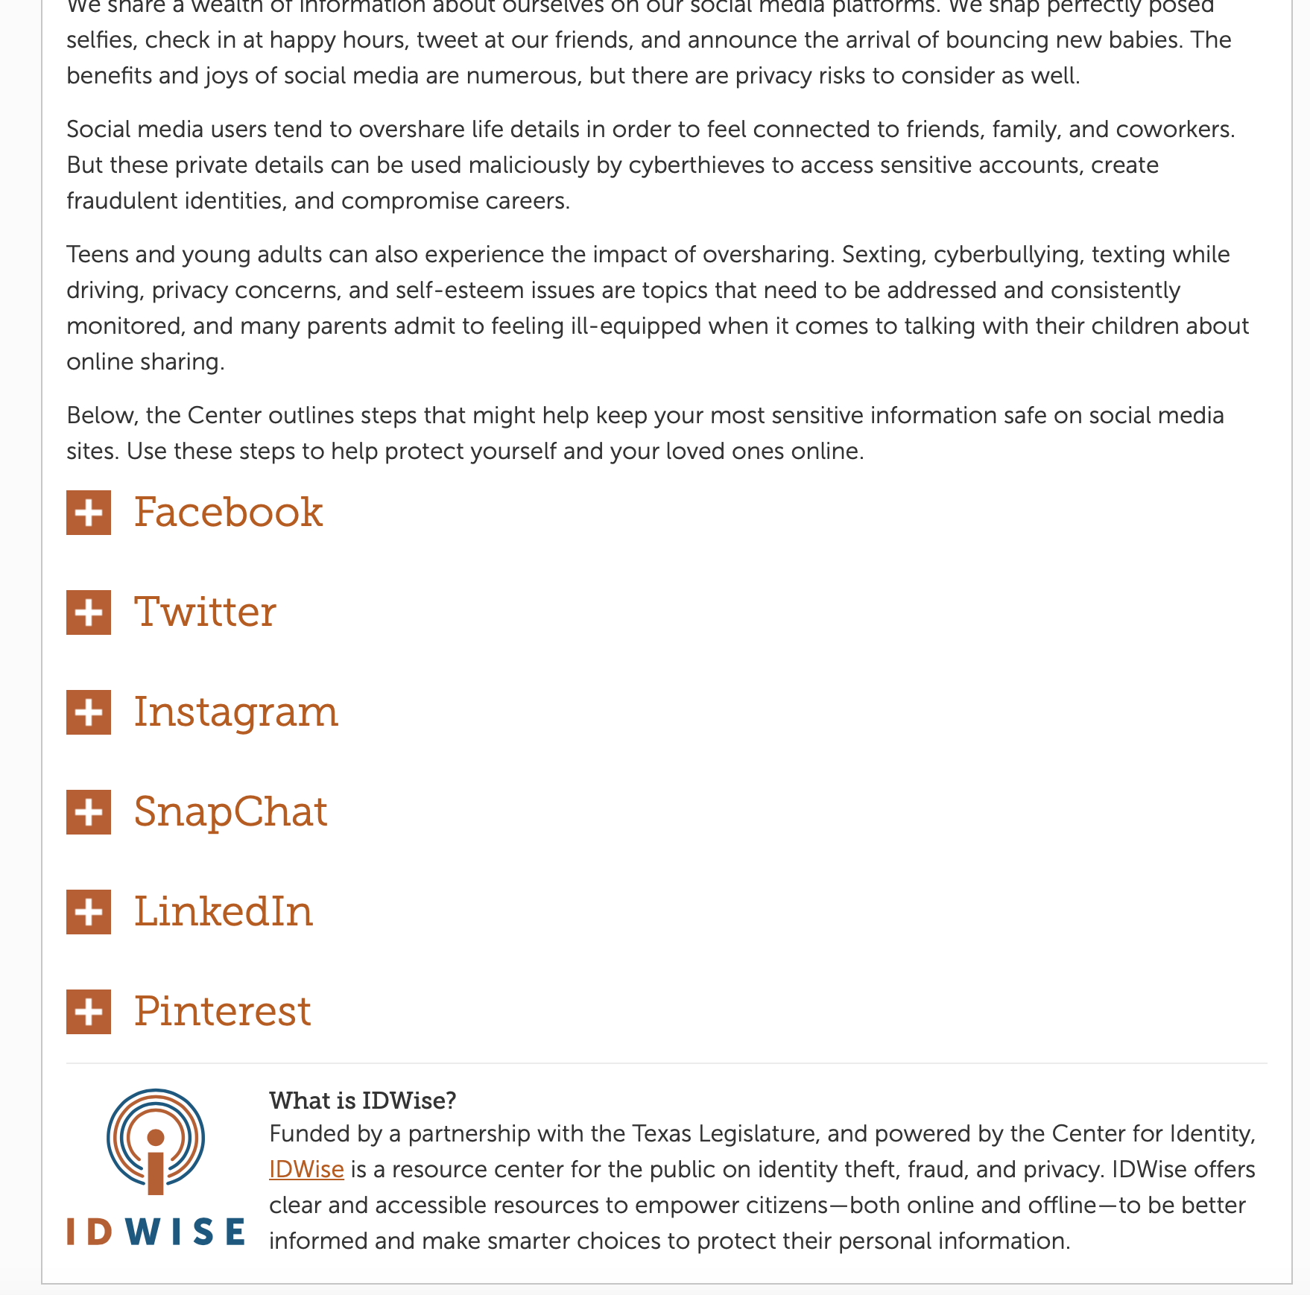
Privacy settings on common SNSs
https://identity.utexas.edu/everyone/how-to-manage-your-social-media-privacy-settings

Slide 47
Questions
Are current interventions available on ONSs enough?
If not, what would you change?
How does technical expertise impact choice of privacy strategies for ONSs?

Slide 48
Logistics
Homework #3 released due by Oct 08, 2020 by 11:59pm
Midterm Exam on Oct. 01, 2020 [available on Moodle during class time]
DE students are encouraged to take it during class time. IF not possible ‘CONTACT ME’ before Oct. 01.
Anyone who can’t attend exam during normal class time with valid presentable reason contact me immediately.
Review class next week. So please use the class to go over contents that you didn’t quite understand (post on Piazza about topic of content and I’ll talk about it in class)

